Slide 1





01
FOOD PROCESSING AND PRESERVATION OF PANEER AND CHEESE

Slide 2

INTRODUCTION
02
Paneer and cheese are essential dairy products obtained
through the coagulation of milk proteins. They differ in the
method of coagulation, texture, moisture content, and ripening
process. The study of their processing and preservation helps
in improving quality, safety, and shelf life.

Slide 3
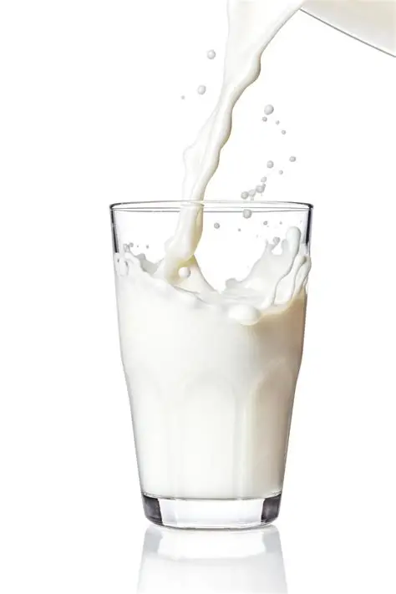

03
Principles of Processing
Based on the coagulation of milk casein by acid or enzymatic action.
Removal of whey and conversion into curd mass.
Controlled temperature, pH, and time influence texture and flavor.
Application of heat and mechanical operations ensures microbial safety.
Packaging and storage conditions maintain product stability

Slide 4
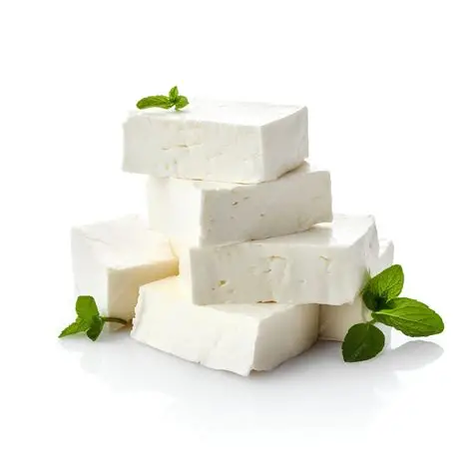
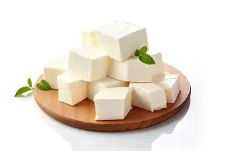
Ingredients Used
04
Paneer:
Fresh milk (cow or buffalo)
Acid coagulant (citric/lactic acid,
vinegar, or lemon juice)
Water for cooling and washing

Slide 5
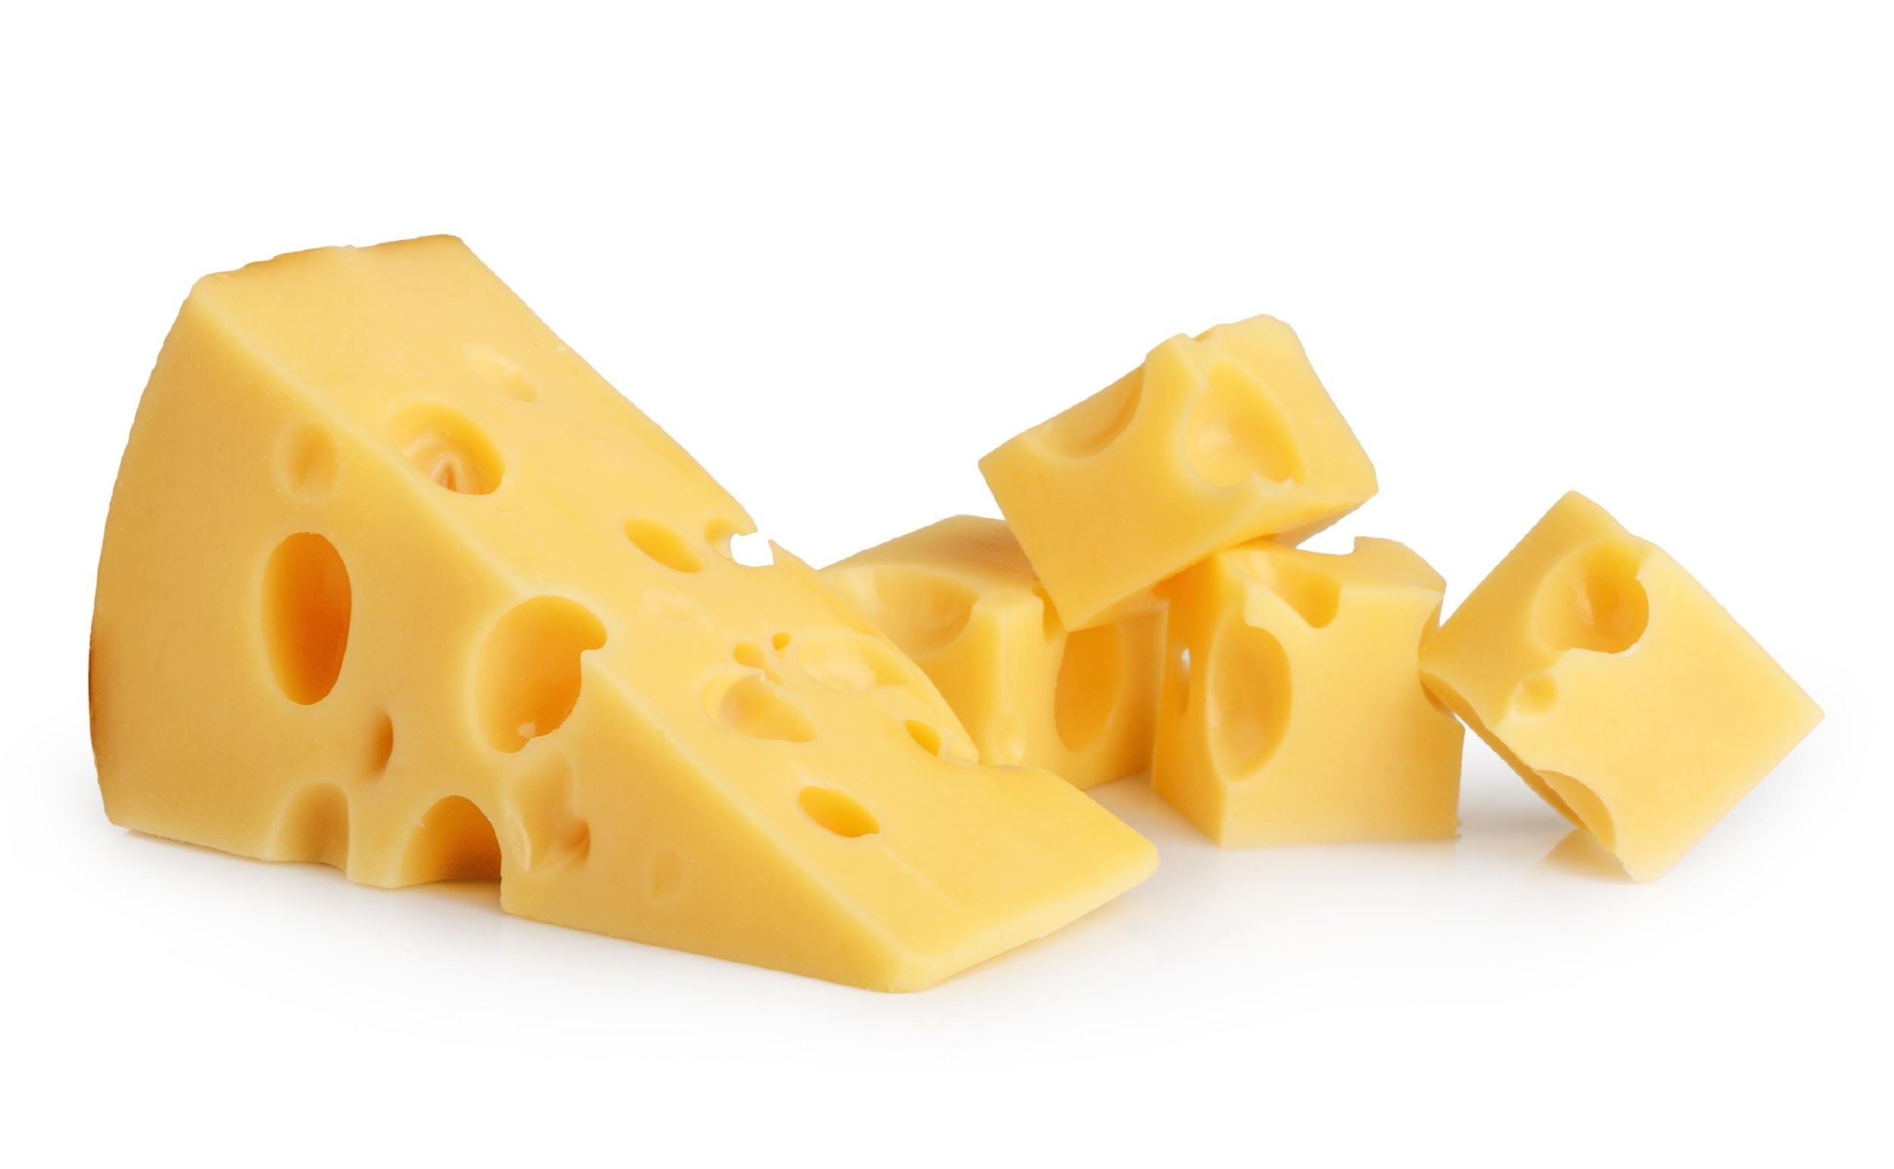
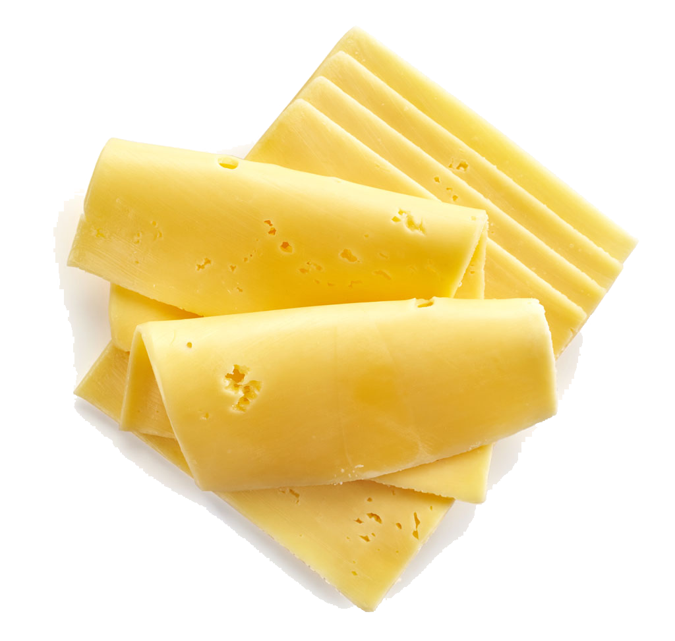
05
Cheese:
Pasteurized milk
Starter cultures (Lactococcus or
Lactobacillus species)
Rennet enzyme
Salt for flavor and preservation

Slide 6
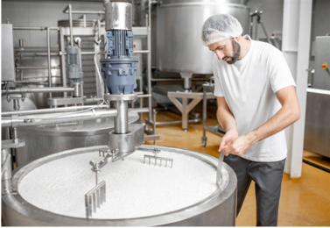
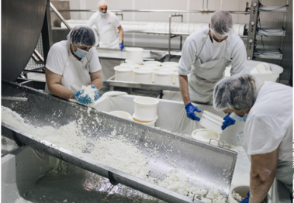
Technology Used – Paneer
06
Filtration and standardization of milk (6% fat, 9% SNF)
Heating to 90°C for 5–10 minutes
Cooling to 70°C and adding acid coagulant
Curd separation and pressing
Cooling in chilled water (4°C) and cutting into blocks
Packaging in vacuum or modified atmosphere

Slide 7
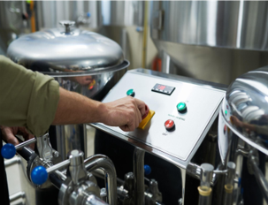
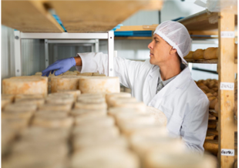
Technology Used – Cheese
07
Pasteurization of milk at 72°C for 15 seconds
Addition of starter cultures for acid development
Rennet addition for coagulation (30–45 minutes)
Cutting and heating curd for whey removal
Pressing, salting, and shaping
Ripening under controlled temperature and humidity

Slide 8
Preservation Techniques
08
Refrigeration at 4°C to slow microbial activity
Vacuum and modified atmosphere packaging
Salting and reduction of moisture content
Use of natural preservatives (nisin, lysozyme)
Maintaining hygienic handling and storage conditions

Slide 9
Advantages of Processing
09
Increased shelf life and safety
Value addition and reduced wastage of milk
Enhanced flavor and texture through controlled processing
Retention of nutritional components
Expansion of product range and marketability

Slide 10
Disadvantages / Challenges
10
High production and equipment costs
Limited shelf life of paneer compared to cheese
Risk of microbial contamination if hygiene is poor
Nutrient loss during heating
Need for refrigeration and cold chain maintenance

Slide 11
Reference
11
Food Safety and Standards Authority of India (FSSAI). (2021). Manual of Methods of Analysis of Foods – Milk and Milk Products. Ministry of Health and Family Welfare, Government of India.
→ Used for hygienic handling, preservation temperature (4°C),
and safety standards.
National Dairy Research Institute (NDRI). (2020).Dairy Technology Handbook. ICAR–NDRI, Karnal, India.
→ Covers paneer and cheese manufacturing, equipment,
and preservation processes.
Walstra, P., Wouters, J. T. M., & Geurts, T. J. (2019). Dairy Science and Technology. CRC Press.
→ Explains milk coagulation chemistry, enzymatic action, and heat treatments
in cheese making.
Fox, P. F., McSweeney, P. L. H., Cogan, T. M., & Guinee, T. P. (2017). Cheese: Chemistry, Physics and Microbiology (4th ed.). Academic Press.
→ Used for microbial control, ripening, and hurdle technology application.
Indian Council of Agricultural Research (ICAR). (2018). Dairy Processing Manual . ICAR Publication, New Delhi.
→ Provides standardized paneer and cheese process parameters used in Indian dairy industries.

Slide 12
Conclusion
12
Paneer and cheese processing combine traditional knowledge with modern
technology.
Understanding processing principles ensures quality and preservation.
Hurdle technology enhances product stability and shelf life.
Dairy processing continues to play a vital role in nutrition and food industry growth.

